Slide 1
Convolutional Neural Networks (CNN)
CNN Architecture.
By Regan Muthomi

Slide 2
Introduction
A CNN is a deep learning algorithm which can take in an input image, assign importance to various aspects in the image and be able to differentiate one from the other.
Since a digital image is represented in number between 0 and 255, its possible to perform computation in the images.
Applications
Facial Recognition
Self Driving cars.
Health Care, Biology, Medicine.

Slide 3

Basic Architecture

Slide 4
CNN
The first role of a CNN is to reduce the images into a form which is easier to process without loosing the features which are critical for getting a good prediction.
A CNN is able to successfully capture the Spatial and Temporal dependencies in an image through the application of relevant filters. The architecture performs a better fitting to the image dataset due to the reduction in the number of parameters involved and reusability of weights. In other words, the network can be trained to understand the sophistication of the image better.
A CNN has 5 main layers:
Convolution Layer.
Non Linearity Layer.
Pooling Layer.
Flattening Layer.
Fully Connected Layer.

Slide 5
1. Convolution Layer.
The goal of this layer is to reduce the size of the image and make processing easy and faster.
In this layer the image is detected and convolution operation performed on the image.
Convolution operation is an elementwise matrix multiplication between the input image and the a feature detector known as a Filter or Kernel. The Kernel is a matrix of dimensions 3x3, 5x5 etc.
The kernel shifts every time performing a matrix multiplication between itself and the portion of the input image over which its hovering. These shifts are called Strides.
The kernel moves to the right with the specified stride value till it parses the entire width. Moving on it hops down to the beginning (left) of the image with the same stride value and repeats the process until the entire image is traversed.
The output of this matrix multiplication is what I called a convolved feature or feature map

Slide 6
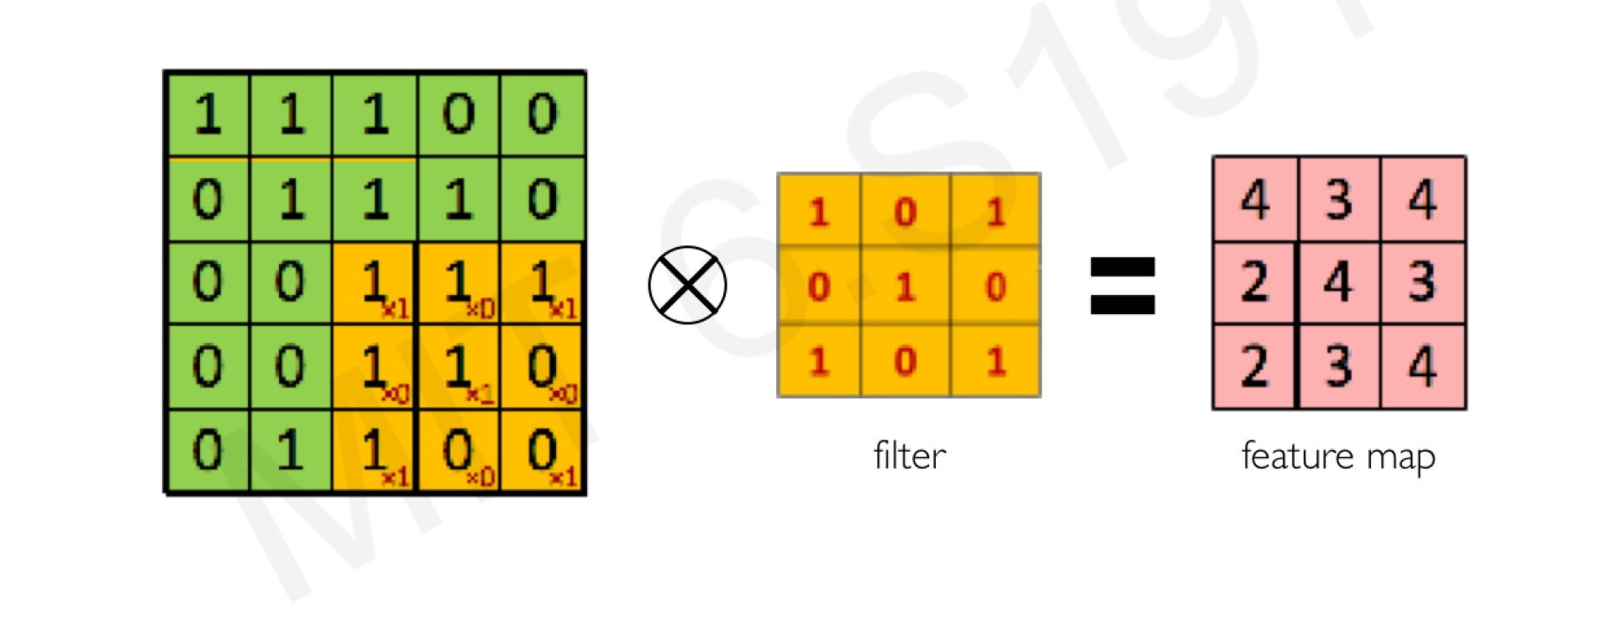
…Convolution Layer.
Convolution.

Slide 7
…Convolution layer
In the case of images with multiple channels e.g. RGB, the kernel has the same depth as the that of the input image.
Matrix multiplication is performed between Kn and In stacks ([K1, I1]; [K2, I2]; [K3, I3]) and all results are summed with the bias to give a squashed one depth channel convoluted feature output.

Slide 8
…Convolution layer
The objective of the convolution operation is to extract the high level features from the input images.
CNN need not to be restricted to only one layer.
The first layer is responsible for capturing the low level features such as color gradient orientation, edges etc.
With added layer, the architecture adapts to the high level feature as well as giving us a network that has the understanding of the dataset.

Slide 9
2. Introduce Non-Linearity
Non linearity is introduced using an activation function. The most common being ReLU (Rectified Linear Unit).
Other activation functions for introducing non linearity include Sigmoid Function and Tanh.
ReLU works by replacing all negative values in each pixel with zero.
Without introducing non linearity, the image classification would be treated like a linear problem by the neural network.

Slide 10
3. Pooling.
Pooling enables the CNN to detect the features in various images irrespective of the difference in lighting in the images and angle of the image.
Pooling also reduces the size of the convolved feature hence reducing the computational power required to process the data through dimensionality reduction.
Its also useful in extracting only the dominant features in the images hence reducing overfitting which may occur of the CNN is given a lot of information which is not relevant in classifying the image.
In pooling we also make use of a kernel and a specified stride value.

Slide 11
..pooling
There are two type in pooling in CNN: Max Pooling and Average Pooling.
Max pooling returns the maximum value from the portion of the image covered by the Kernel.
Average pooling on the other hand returns the average of the portion of the image covered by the Kernel.
Max pooling also serves as a Noise Suppressant. It discards the noisy parts of the image as well as dimensionality reduction.
Average pooling only performs dimensionality reduction as a noise suppressing mechanism.
Therefore we can say that Max pooling performs better than average pooling.
The output of pooling is now called a pooled feature map.

Slide 12
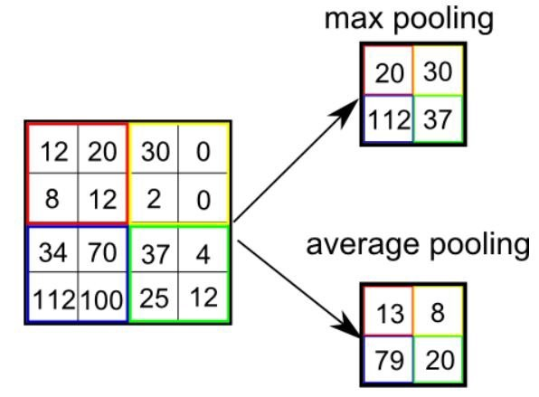
…Pooling
If you want a CNN with more than one Convolutional Layer, repeat the steps above.

Slide 13
4. Flattening
Flattening involves transforming the pooled feature map into a single column which now fed to the Neural Network for processing.

Slide 14
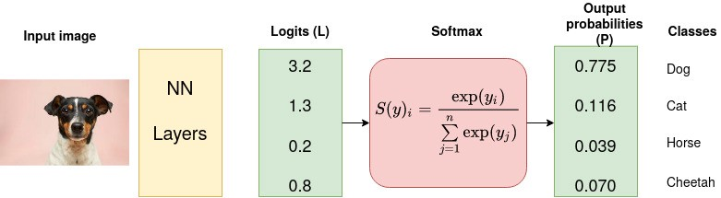
Fully connected Layer
The flattened output is fed to the feed forward neural network. Information is passed through the network and the error of prediction is calculated.
The error is the back propagated through the network to minimize the error and improve the prediction.
The fully connected layer after computations, outputs a vector of logits that is passed through a SoftMax activation function that transform the logits to probabilities for each class. (Can also use sigmoid function.
The class with the highest probability value becomes the predicted class.

